Slide 1
HW7 Ch. 5.7-10 Solution
金緒勳
綜二R737
kim60138@gmail.com

Slide 2
Disjoint Set
Quick Find
Simple Union with Simple Find
Weighted Union with Collapsing Find

Slide 3
Quick Find
Using array or linked list
Eg. DS = {0, 1, 2, 5}, {3, 6, 7}, {4}
Array:
Linked list:
id | 0 | 1 | 2 | 3 | 4 | 5 | 6 | 7
Set | S1 | S1 | S1 | S2 | S3 | S1 | S2 | S2
S1
S2
S3
0
1
2
5
3
6
7
4

Slide 4
Union with Quick Find
Using array or linked list
Eg. DS = {0, 1, 2, 5}, {3, 6, 7}, {4}
Array:
Linked list:
id | 0 | 1 | 2 | 3 | 4 | 5 | 6 | 7
Set | S1 | S1 | S1 | S1 | S3 | S1 | S1 | S1
S1
S2
S3
0
1
2
5
3
6
7
4

Slide 5
Union with Quick Find
Time complexity:
Union ➔ O(n)
Find ➔ O(1)
How to improve the union(i, j) operation?
Simple Union and Simple Find

Slide 6
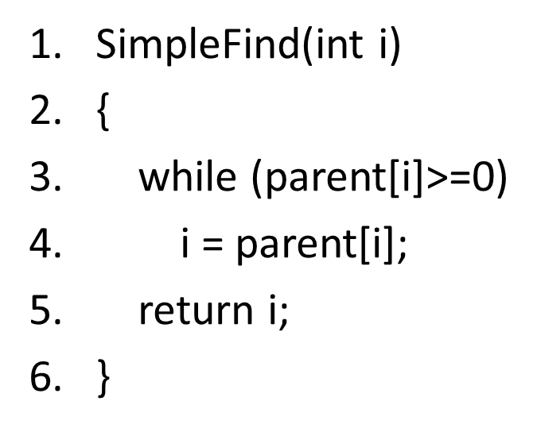
Simple Find
Using array or linked list
Eg. DS = {0, 1, 2, 5}, {3, 6, 7}, {4}
Array:
Linked list:
id | 0 | 1 | 2 | 3 | 4 | 5 | 6 | 7
parent | -1 | 0 | 0 | -1 | -1 | 0 | 3 | 6
3
0
4
6
1
2
5
7

Slide 7
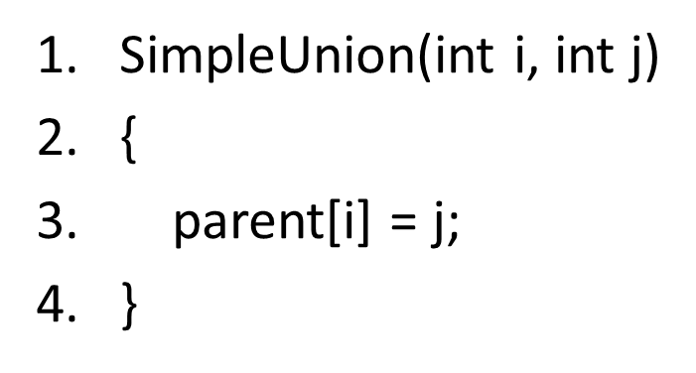
Simple Union
Using array or linked list
Eg. DS = {0, 1, 2, 5}, {3, 6, 7}, {4}
Array:
Linked list:
id | 0 | 1 | 2 | 3 | 4 | 5 | 6 | 7
parent | 3 | 0 | 0 | -1 | -1 | 0 | 3 | 6
3
0
4
6
1
2
5
7

Slide 8
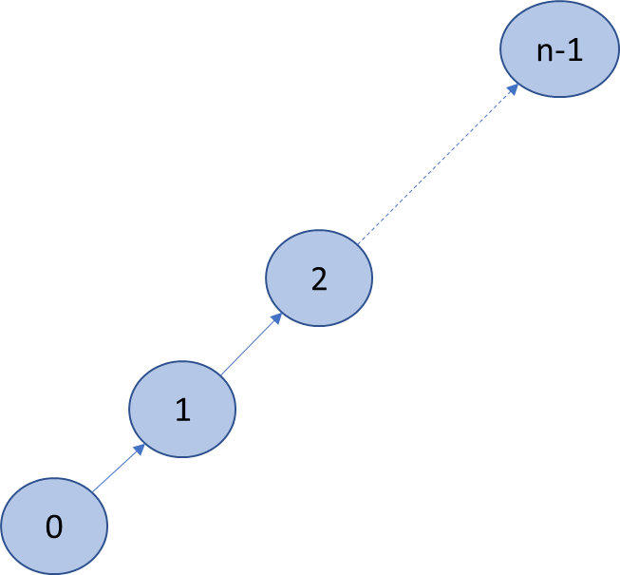
Simple Union
Consider the following situation:
Union(0,1)➔Union(1,2) ➔Union(2,3)➔…..➔Union(n-2,n-1)
In this situation, find(x) operation would have O(n) time in average case.
Random union may cause performance degradation of find operations.

Slide 9
Simple Find with Simple Union
Time complexity:
Union ➔ O(1)
Find ➔ O(n)
Can we provide a win-win solution for find(i) and union(i, j) operations ?
Weighted Union

Slide 10
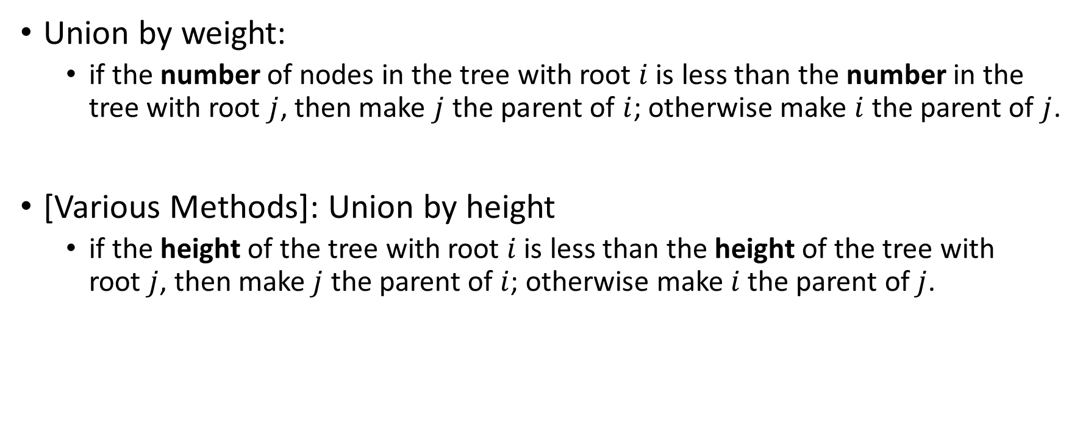
Weighted Union
Union by weight:
if the number of nodes in the tree with root $i$ is less than the number in the tree with root $j$, then make $j$ the parent of $i$; otherwise make$i$ the parent of $j$.
[Various Methods]: Union by height
if the height of the tree with root $i$ is less than the height of the tree with root $j$, then make $j$ the parent of $i$; otherwise make$i$ the parent of $j$.

Slide 11
Weighted Union with Simple Find
Time complexity:
Union: O(1)
Find: O(log n)
Is it possible to improve further?
Weighted Union with Collapsing Find

Slide 12


Collapsing Find
path compression:
After$Find\left(i\right),$ $$if( j is a node on the path from i to its root) and (parent\left[i\right]≠ root\left(i\right)), \\ then parent[j] is set to root.$$
r
r
a
c
$$After Find(i)$$
i
b
a
c
b
i
d
d

Slide 13

Weighted Union with Collapsing Find
Time complexity:
Union: O(1)
Find: O($α(n)$)
Inverse Ackermann $α$
$α\left(n\right)=\frac{1}{A\left(n,n\right)}$ (in practice, this value is at most 4)

Slide 14
Q1:
Construct a BST from the given preorder traversal result: 15, 4, 1, 12, 10, 20, 30. Explain your approach.

Slide 15
A1:
Preorder : 15, 4, 1, 12, 10, 20, 30
15 is the root of this binary search tree
Due to binary search tree
{4, 1, 12, 10} is the left subtree, {20, 30} is right subtree
And so on….

Slide 16
A1:
15
4
20
1
12
30
10

Slide 17
Q2:
Construct a BST from the given postorder traversal result: 2, 6, 4, 9, 13, 11, 7. Explain your approach.

Slide 18
A2:
Postorder : 2, 6, 4, 9, 13, 11, 7
7 is the root of this binary search tree
Due to binary search tree
{2, 6, 4} is the left subtree, {9, 13, 11} is right subtree
And so on….

Slide 19
A2:
7
4
11
2
6
9
13

Slide 20
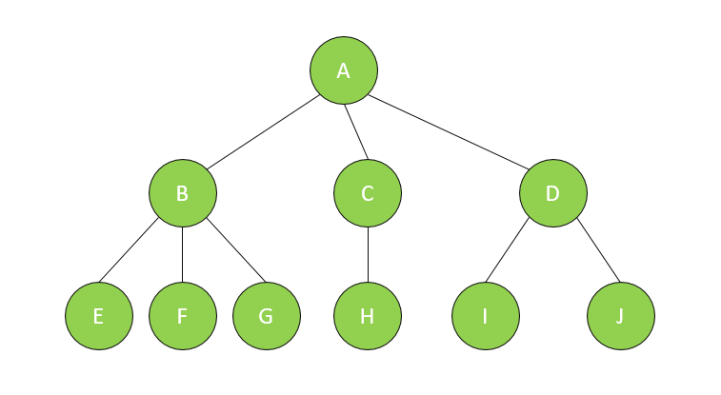
Q3 (A) :
Please propose and explain your solutions to the following processes.
(A) Transform a tree into a binary tree

Slide 21
A3 (A):
(A) left-child right-sibling
A
B
C
D
E
F
G
H
I
J

Slide 22
A3 (A):
(A) left-child right-sibling
A
B
C
D
E
F
G
H
I
J

Slide 23
A3 (A):
(A) We can transform this tree to a binary tree by turning each sibling 45° clockwise
A
B
E
C
F
H
D
G
I
J

Slide 24
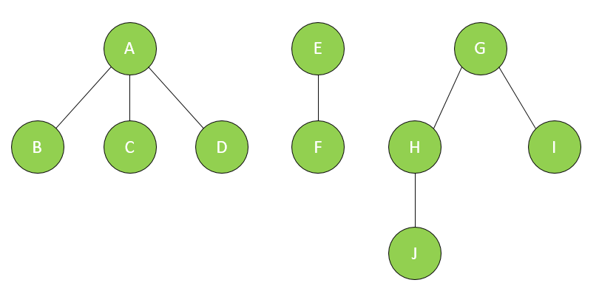
Q3 (B):
(B) Please propose an algorithm that can transform a forest into binary tree

Slide 25
A3 (B):
(B) left-child right-sibling
A
E
G
B
C
D
F
H
I
J

Slide 26
A3 (B):
(B) We can transform this tree to a binary tree by turning each sibling 45° clockwise
A
B
E
C
F
G
D
H
J
I

Slide 27
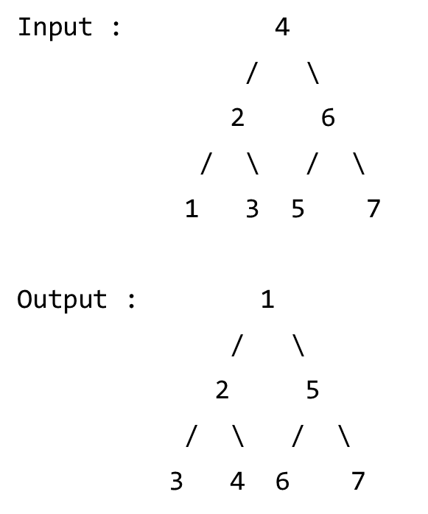
Q4:
Please discuss how to convert a given complete binary search tree into a Min Heap in which every node has its total left subtree node value less than its total right subtree node value.

Slide 28
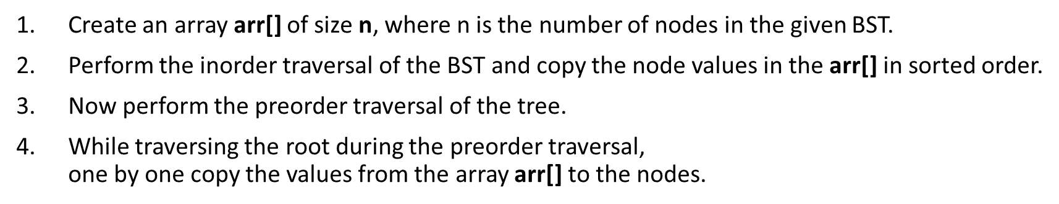
A4:

Slide 29
Q5:
Union is a basic function used in the disjoint set data structure. If you are to construct a set which includes the elements x1, x2, …, xn, starting from an empty set. (i.e. x1, x2, …, xn should be in the same set)
Please calculate the total number of operations (make-set and union) needed to establish the set.
What is the worst-case time complexity? Please explain your analysis process.

Slide 30

A5:
n make-set and (n-1) union
Union with quick find:
Union(0,1)➔Union(1,2) ➔…..➔Union(n-2, n-1)
Union(0,1):
Union(1,2)
And so on….
➔O($n^{2}$)
id | 0 | 1 | 2 | 3 | … | … | … | n-1
Set | S1 | S1 | S2 | S3 | … | … | … | Sn-1
id | 0 | 1 | 2 | 3 | … | … | … | n-1
Set | S2 | S2 | S2 | S3 | … | … | … | Sn-1

Slide 31
Q6:
According to the exercise 5 . Can you think of any other approach to speed up the union function? If yes, please describe how it works and analyze the time complexity of the methodology.

Slide 32
A6:
Simple Find with Simple Union (page 9)
Weighted Union with Collapsing Find (page 13)

Slide 33
Q7:
Given the disjoint set DS = {0, 1, 2, 5}, {3, 6, 7}, {4}, please show how you may use an “array” to represent this disjoint set. First describe your data structure and then show the result.

Slide 34
A7:
Method 1:
Method 2:
id | 0 | 1 | 2 | 3 | 4 | 5 | 6 | 7
parent | -1 | 0 | 0 | -1 | -1 | 0 | 3 | 3
Note: -1 means root
id | 0 | 1 | 2 | 3 | 4 | 5 | 6 | 7
Set | S1 | S1 | S1 | S2 | S3 | S1 | S2 | S2

Slide 35
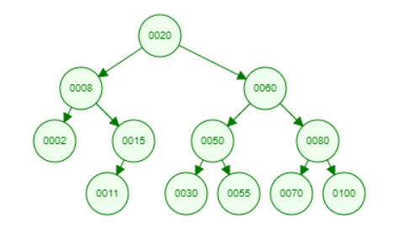
Q8:
Please explain how to delete a node for the following binary tree.
Case 1 : Delete 0002 node
Case 2 : Delete 0015 node
Case 3 : Delete 0050 node
Every tree node has three pointers to its parent, left child, right child. You should explain how to adjust the pointer after a node deletion.

Slide 36
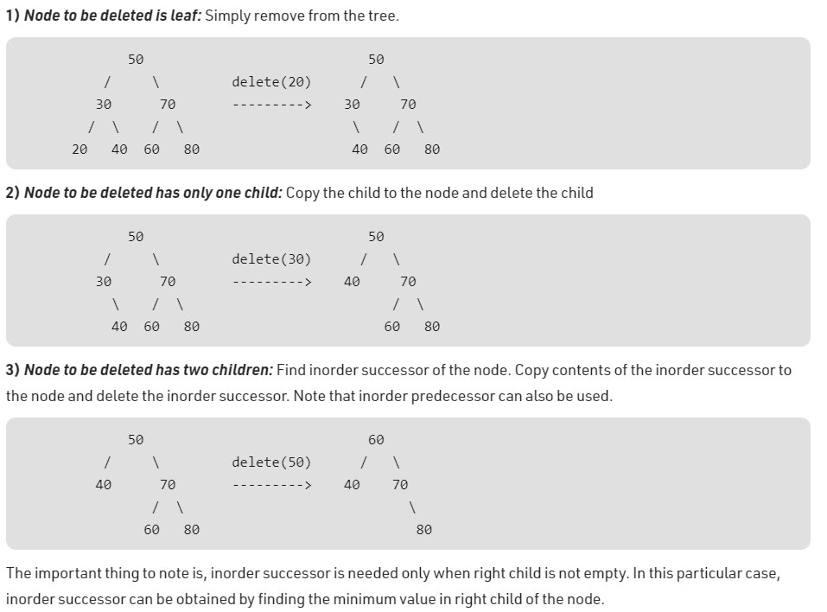
Delete node in BST

Slide 37
A8:
Case 1 : Delete 0002 node
0020
0060
0008
0050
0080
0015
0011
0030
0055
0070
0100

Slide 38
A8:
Case 2 : Delete 0015 node
0020
0060
0008
0050
0080
0002
0011
0030
0055
0070
0100

Slide 39
A8:
Case 3 : Delete 0050 node
0020
0060
0008
0055
0080
0002
0015
0011
0030
0070
0100

